Slide 1

Popular Built-in Functions (1)
Professor Bo Liu
James Watt School of Engineering

Slide 2


Built-in functions
MATLAB has many built-in functions.
To call a mathematical function, enter the function name, then the input/argument in parentheses.
For example, sin of π/2:
The input to the function
The name of the function to be called
See live script

Slide 3
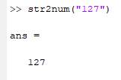
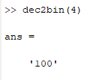
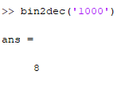
MATLAB datatype conversion
Function | Description
num2str() | Converts a numerical input into a string
int2str() | Converts an integer into a string
char() | Converts a string into an array of characters
dec2bin() | Converts an integer into a binary number
bin2dec() | Converts a binary number into an integer
See live script

Slide 4
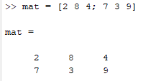

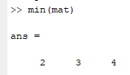
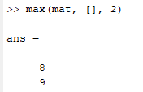
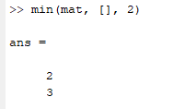
Finding the largest and smallest elements in a matrix
The “max” and “min” provide the maximum and minimum element of the input matrix
  By default, these functions operate along columns
Along columns
Along rows
See live script

Slide 5

Return value unpacking
Some MATLAB functions return multiple values
  By default, all values except the primary return value are ignored
  Here the returned values from the function will be saved into variables “val1” and “val2”.
Unpacking returned value into 2 variables
The input of the function
The name of the function to be called
See live script

Slide 6
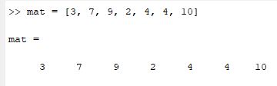


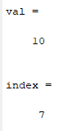

Index of maximum and minimum element
The “max” and “min” functions are two functions that return multiple values.
  “max” returns the value of the maximum element and its index.
  “min” returns the value of the minimum element and its index.
See live script

Slide 7
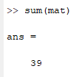
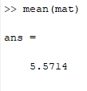
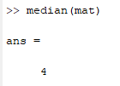
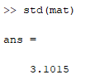
Sum, mean, median, and standard deviation
MATLAB has built-in functions that provide the sum, mean, median, and standard deviation of the input matrix
  By default, these operate along columns.
See live script

Slide 8
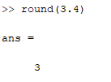
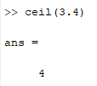
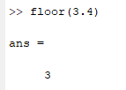
Rounding floating point numbers to integers
The built-in “round” function rounds the input to the nearest integer.
The built-in “ceil” function rounds up to the nearest integer.
The built-in “floor” function rounds down to the nearest integer.
See live script

Slide 9




Thanks!
#UofGWorldChangers
@UofGlasgow

Slide 10
Common arithmetic functions
Function | Description
size() | Return the length of each dimension of the input matrix as a vector.
length() | Return the number of elements of the input vector .
max() and min() | Return the maximum and minimum entry as well as the index where the corresponding element can be found (by column for matrix).
round() | Round the input to the nearest integer.
ceil() and floor() | Round the elements of the input up and down to the nearest integer.
mean() and median() | Return the mean and median of the input vector or matrix (by column for matrix).
std() | Return the standard deviation of the input matrix.
sum() | Return the sum of the input matrix.
For most of these functions, a dimension along which to operate can be specified.
See live script

